Slide 1
Use of LibreOffice in Making a Books
(Book Making with LibreOffice)
OpenSUSE Asia Summit 2019
Aryani Lestari Putri
narasenja06@gmail.com
@AryaniLestari_

Slide 2
Topics
  About Me
  Make the Font Format
  Put the Image in libreoffice
  Set Margins
  Make a Table
  Combining Tables
  Using Page Numbering
  Formatting Paragraphs

Slide 3

About Me
Aryani Lestari Putri
  Universitas Banten Jaya (www.unbaja.ac.id)
  Student of Pancasila Civic Education ( 2016 – Now )
  Speaker of Writing Research Paper with LibreOffice (2018)
  Speaker of Bookmaking Workshop with LibreOffice (2019)

Slide 4
Make the Font Format

Slide 5
Font
  Create a Font
  Formatting Includes Bold, Italic, Underline, Strikethrough format.

Slide 6
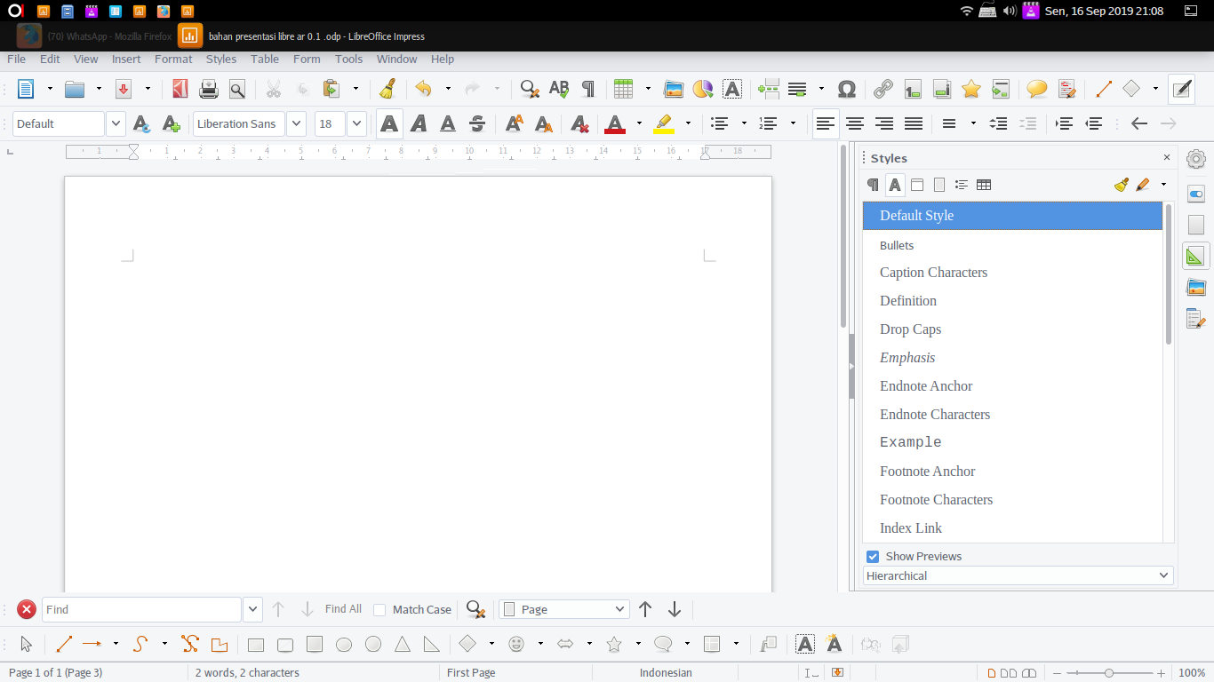
⸺

Slide 7
Put the Image in LibreOffice

Slide 8
Image
  Insert Image
  Open LibreOffice
  Click Insert picutre, or Insert menu → Picture.

Slide 9
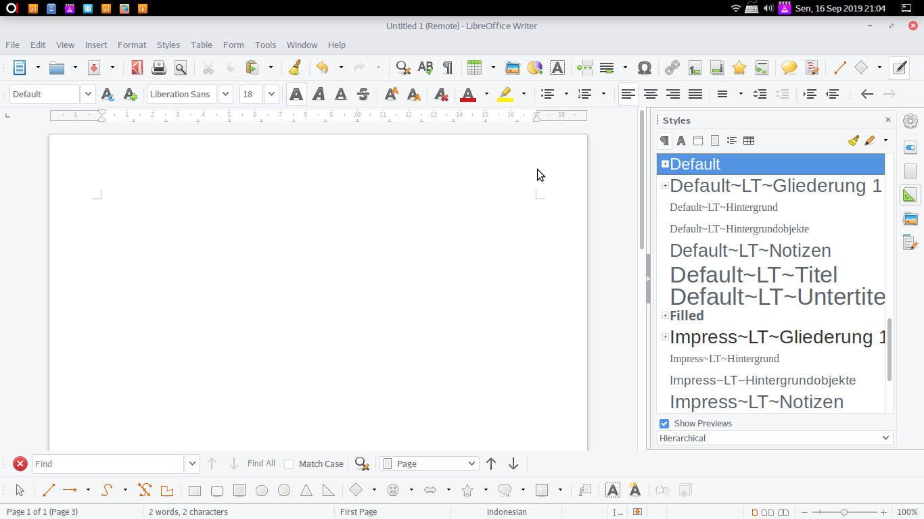
clicking Insert picture, or the Insert menu> Picture.

Slide 10
Set Margins

Slide 11
Margin
  To adjust margins
  Open LibreOffice
  Format → Page → Margin

Slide 12
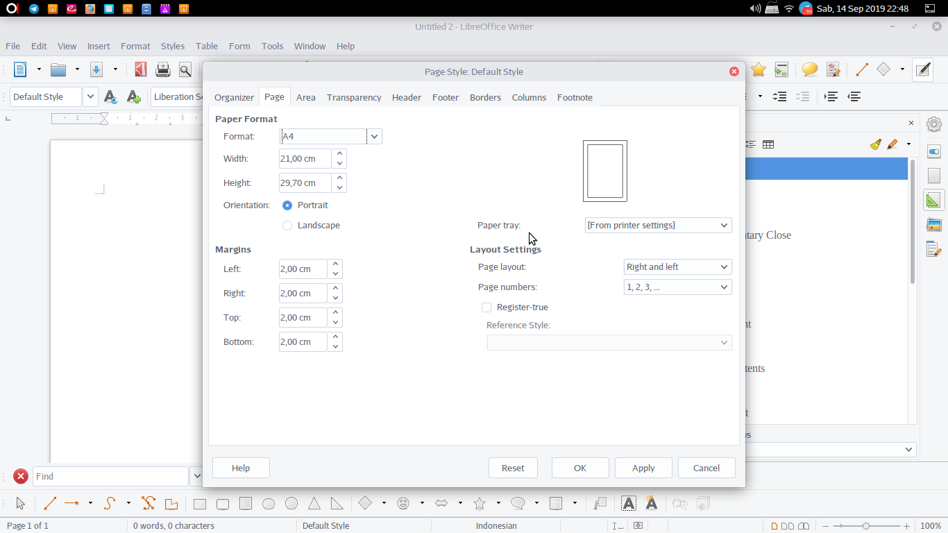
clicking Insert picture, or the Insert menu> Picture.

Slide 13
Make a Table

Slide 14
Table
  To insert a table
  Open LibreOffice
  Clicking on the Table Icon or Table → Insert Table

Slide 15
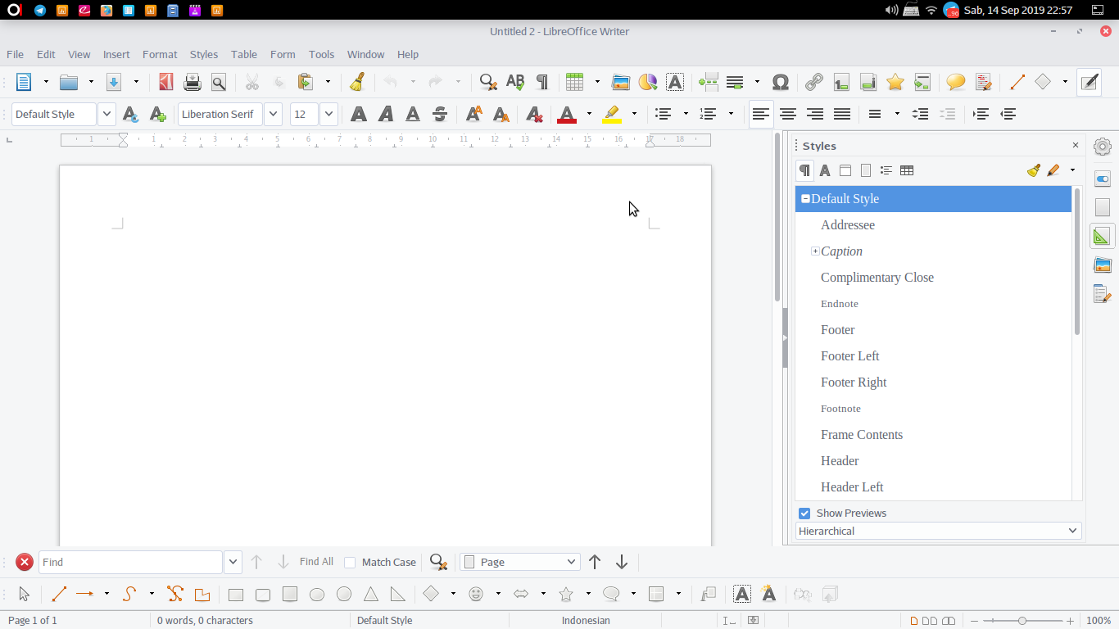
clicking Insert picture, or the Insert menu> Picture.

Slide 16
Combining Tables

Slide 17
Table
  To combine tables you can use…
  Open LibreOffice
  Table → Marge cells or Click the Marge cells icon

Slide 18
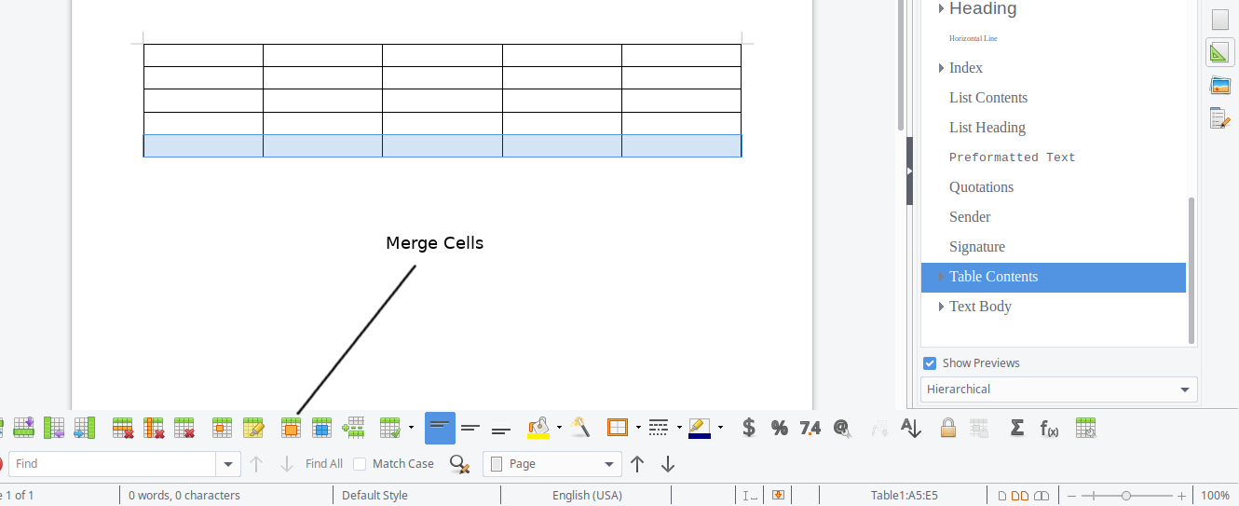
clicking Insert picture, or the Insert menu> Picture.

Slide 19
Using Page Numbering

Slide 20
Page Numbering
  Numbering making…
  Roman numbering
    Open LibreOffice
    Style and Formating → Page Styles → New → Organizer → Page
    Page → i, ii, iii → Footer (Checklist (✓))
  Arabic numbering
    Open LibreOffice
    Style and Formating → Page Styles → New → Organizer → Page
    Page → 1, 2, 3 → Footer (Checklist (✓))

Slide 21
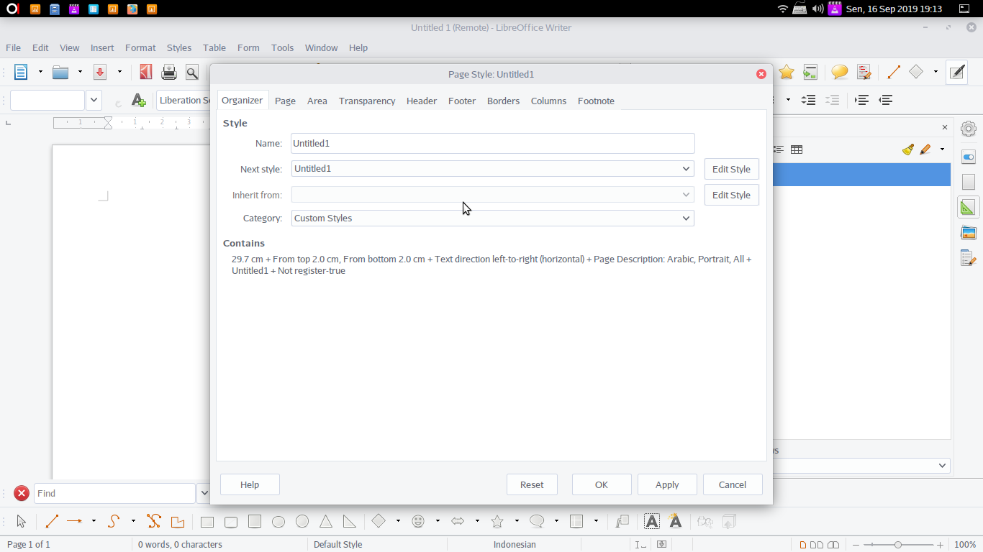
clicking Insert picture, or the Insert menu> Picture.

Slide 22
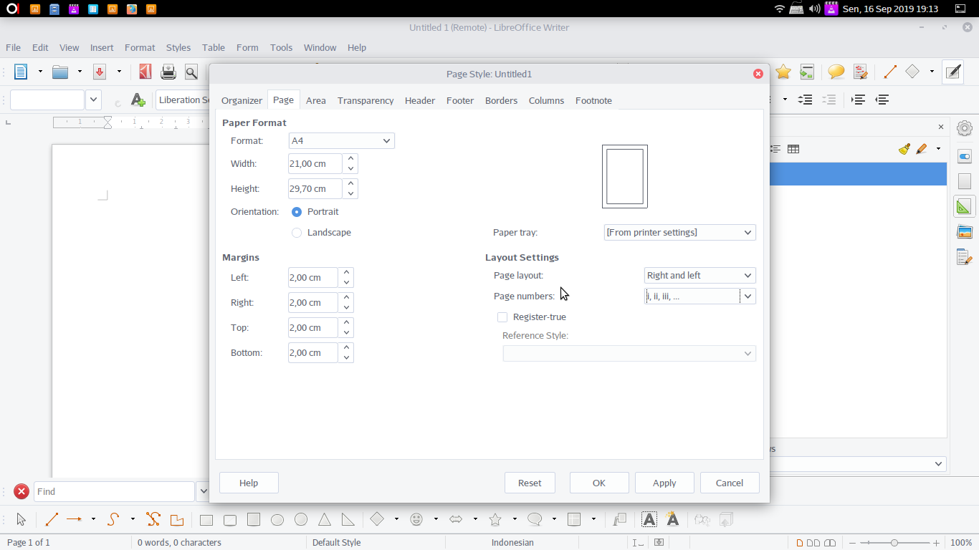
clicking Insert picture, or the Insert menu> Picture.

Slide 23
Page Numbering
  The numbering starts at the specified number.
  Open LibreOffice
  Format →Title Page → Set Page Number for first title page (checklist (✓)) → Adjust the number as needed
  Insert → Field → Page number

Slide 24
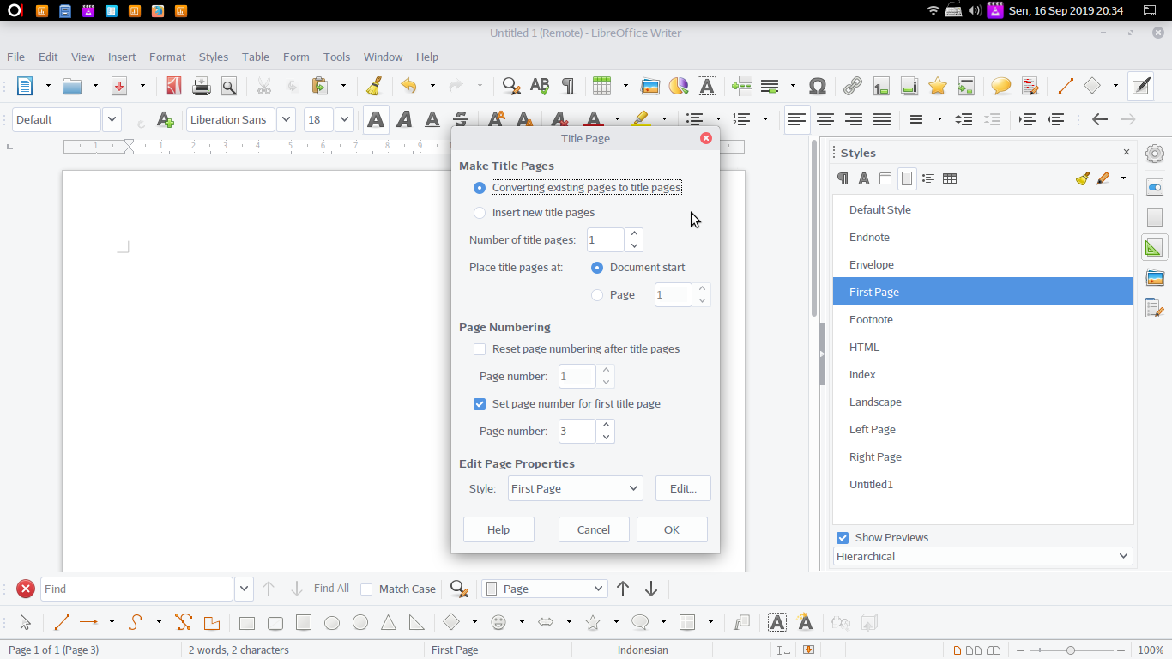
clicking Insert picture, or the Insert menu> Picture.

Slide 25
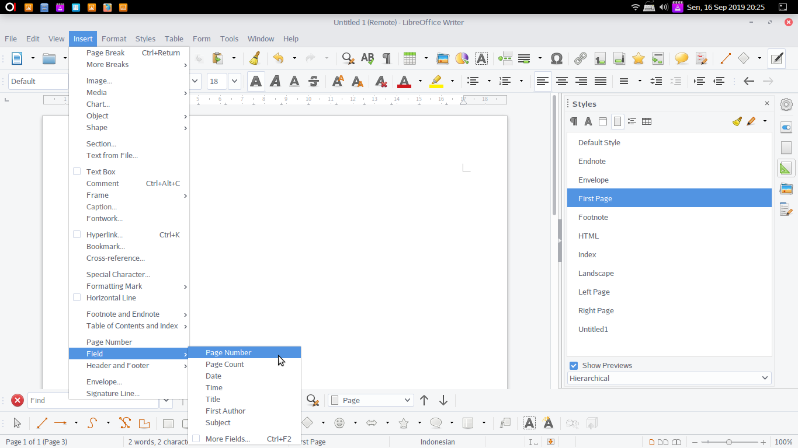
clicking Insert picture, or the Insert menu> Picture.

Slide 26
Formatting Paragraphs

Slide 27
Formatting Paragraphs
  Can be done using a method…
  Sytle → Paragraf → New
  Organizer → (adjust to the format needed)
  Then click 2x on the format that was created

Slide 28
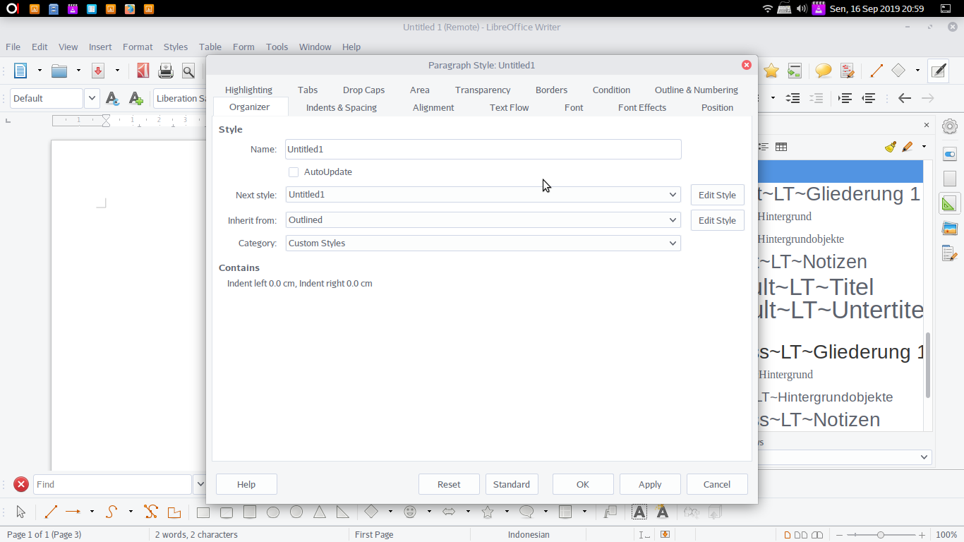
clicking Insert picture, or the Insert menu> Picture.

Slide 29
ANY QUESTION ?

